Slide 1
Introductory Presentation
Team Name: Work In Progress

Slide 2

Management Structure
Mechanical | Electrical | Software
Aadam Iftikhar | Thomas Gaertner | Daniel Rivlin
Gabriel Bednarkiewicz | Andrew Farquharson | Eduard Burlacu
*It is important to note that these are loose descriptions, with members reassigned to various roles as the project requires.

Slide 3
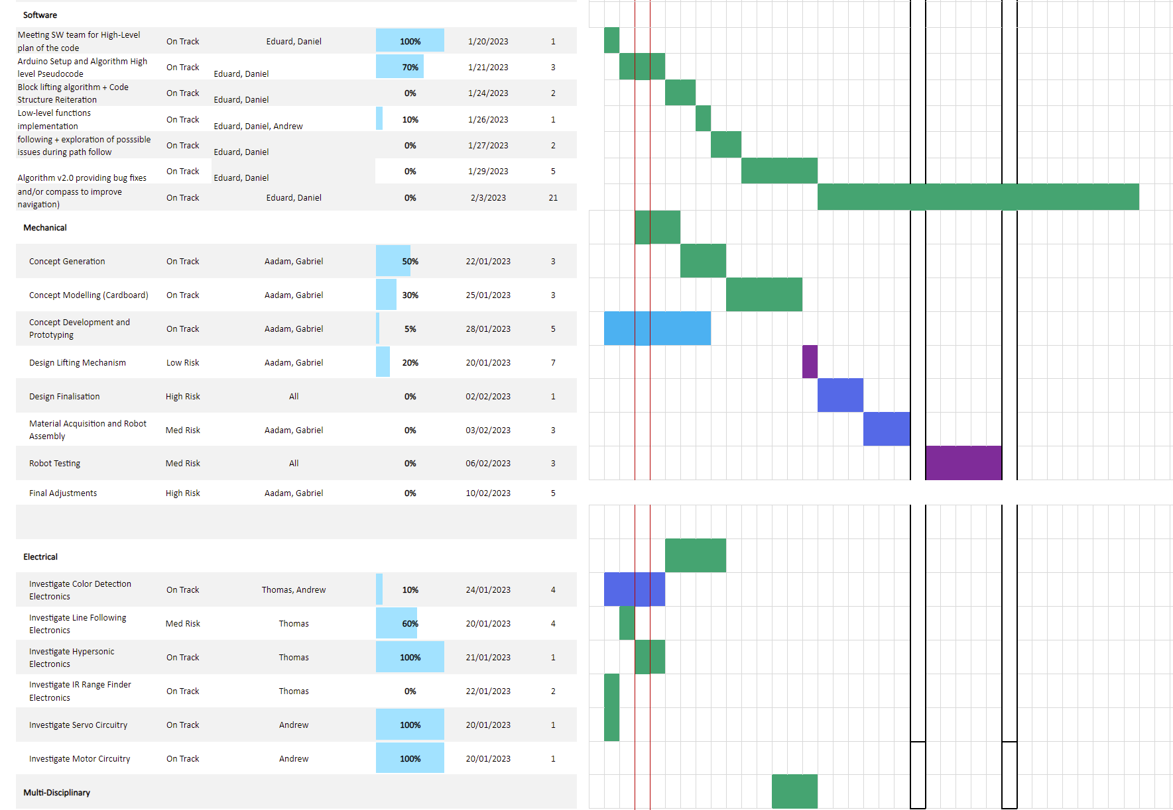
Team Organisation
Created a Gantt Chart including deadlines, work distribution, and projected timeline
Documents and file organisation using cloud storage, version control (GitHub)
Issues and communication addressed on a common groupchat and Issues section of repository

Slide 4

THE PROBLEM
Navigate from start point to end point and back
Drivetrain and navigation system required
Passing through tunnel and over ramp, adds additional constraints
Collect a block from designated point
Lift block 100mm onto truck

Slide 5
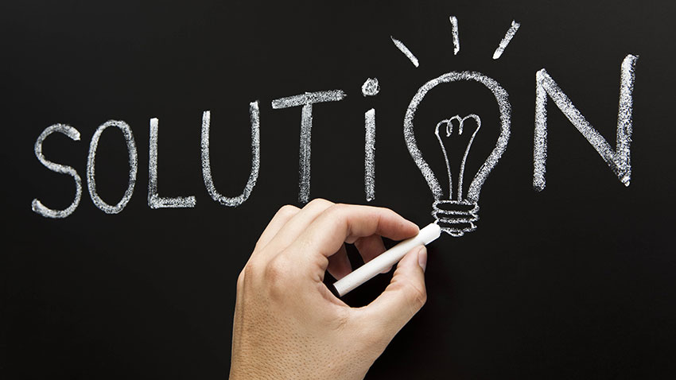
SOLUTION CONCEPTS
Navigation: Line-following (possible compass or computer vision as redundancies)
Drivetrain: Two rear wheels, ball bearing at the front, allows for turning on the spot
Block Collection: claw powered by servo motor
Block Elevation: Use claw attached to lever arm mechanism

Slide 6
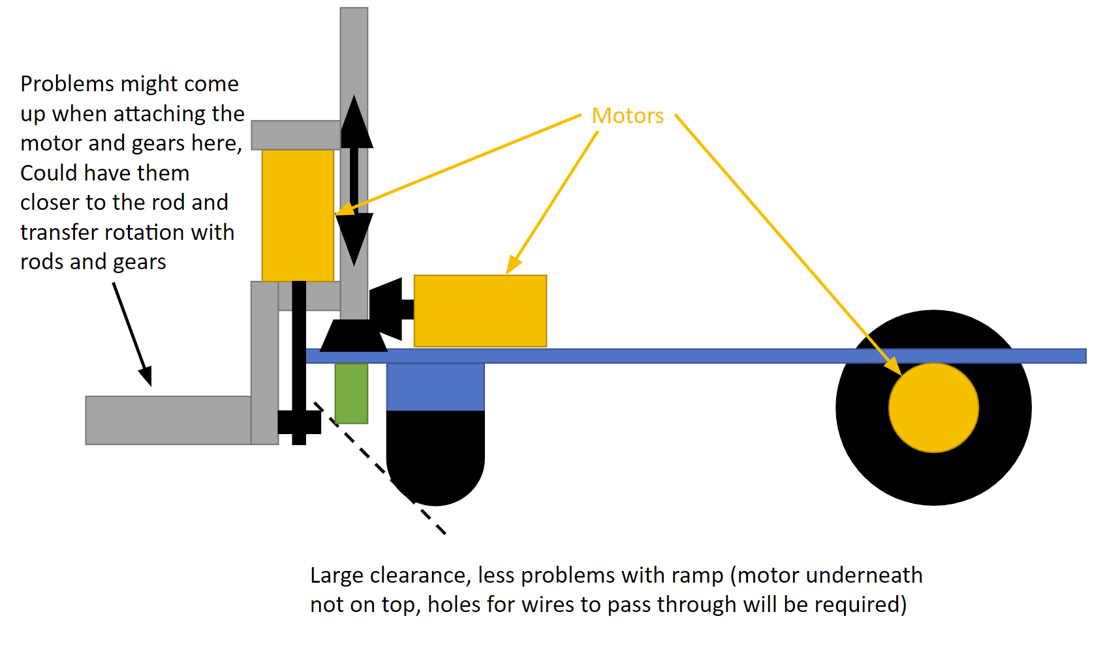
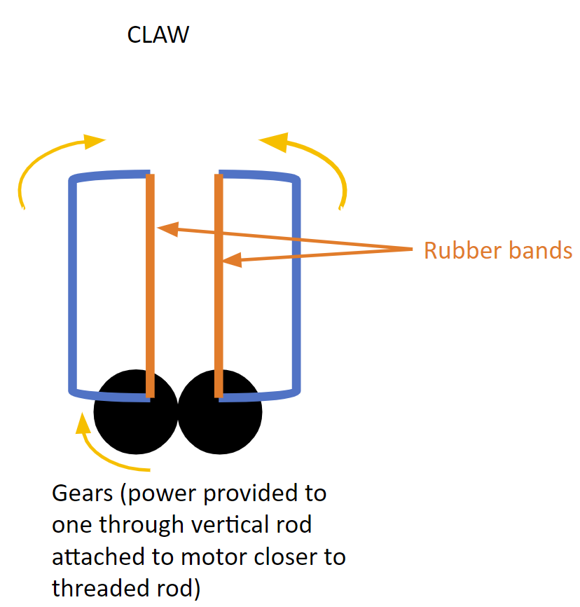
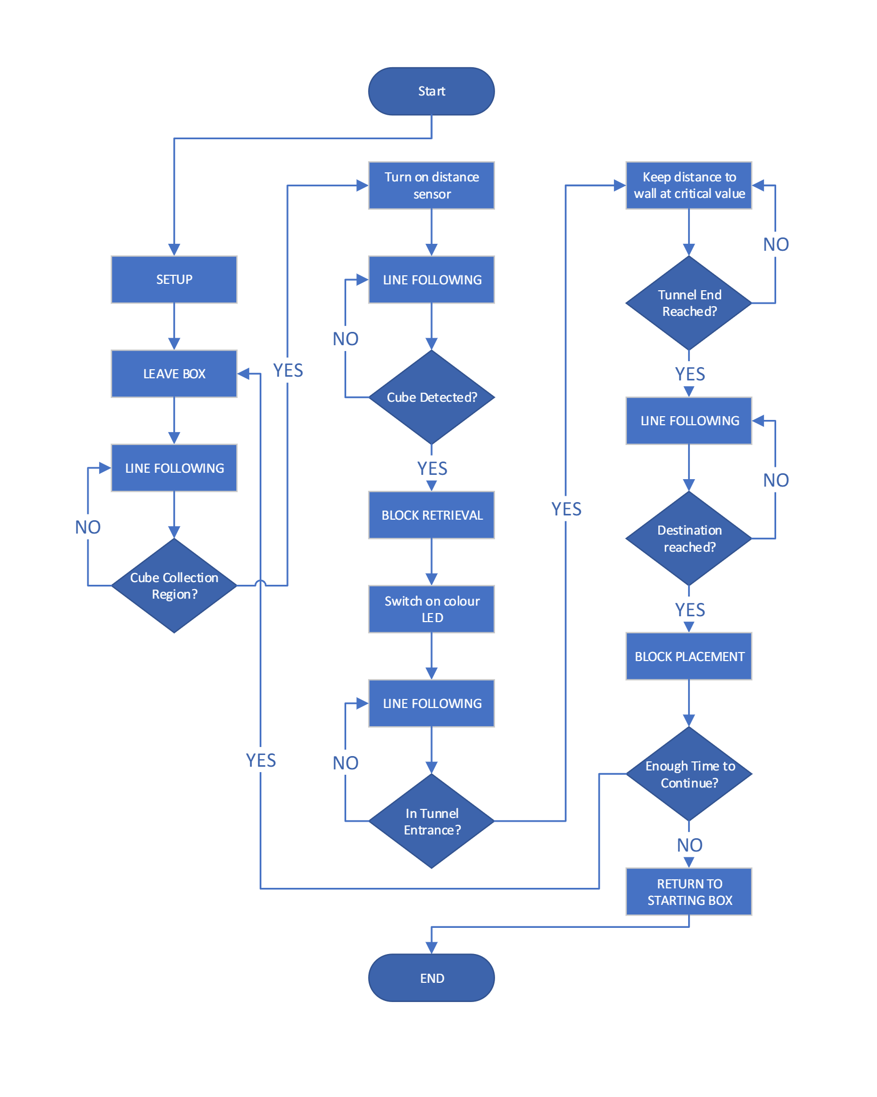
Approaches
Provided prototypes for:
Claw movement
Lift mechanism
Electronics and software logic

Slide 7
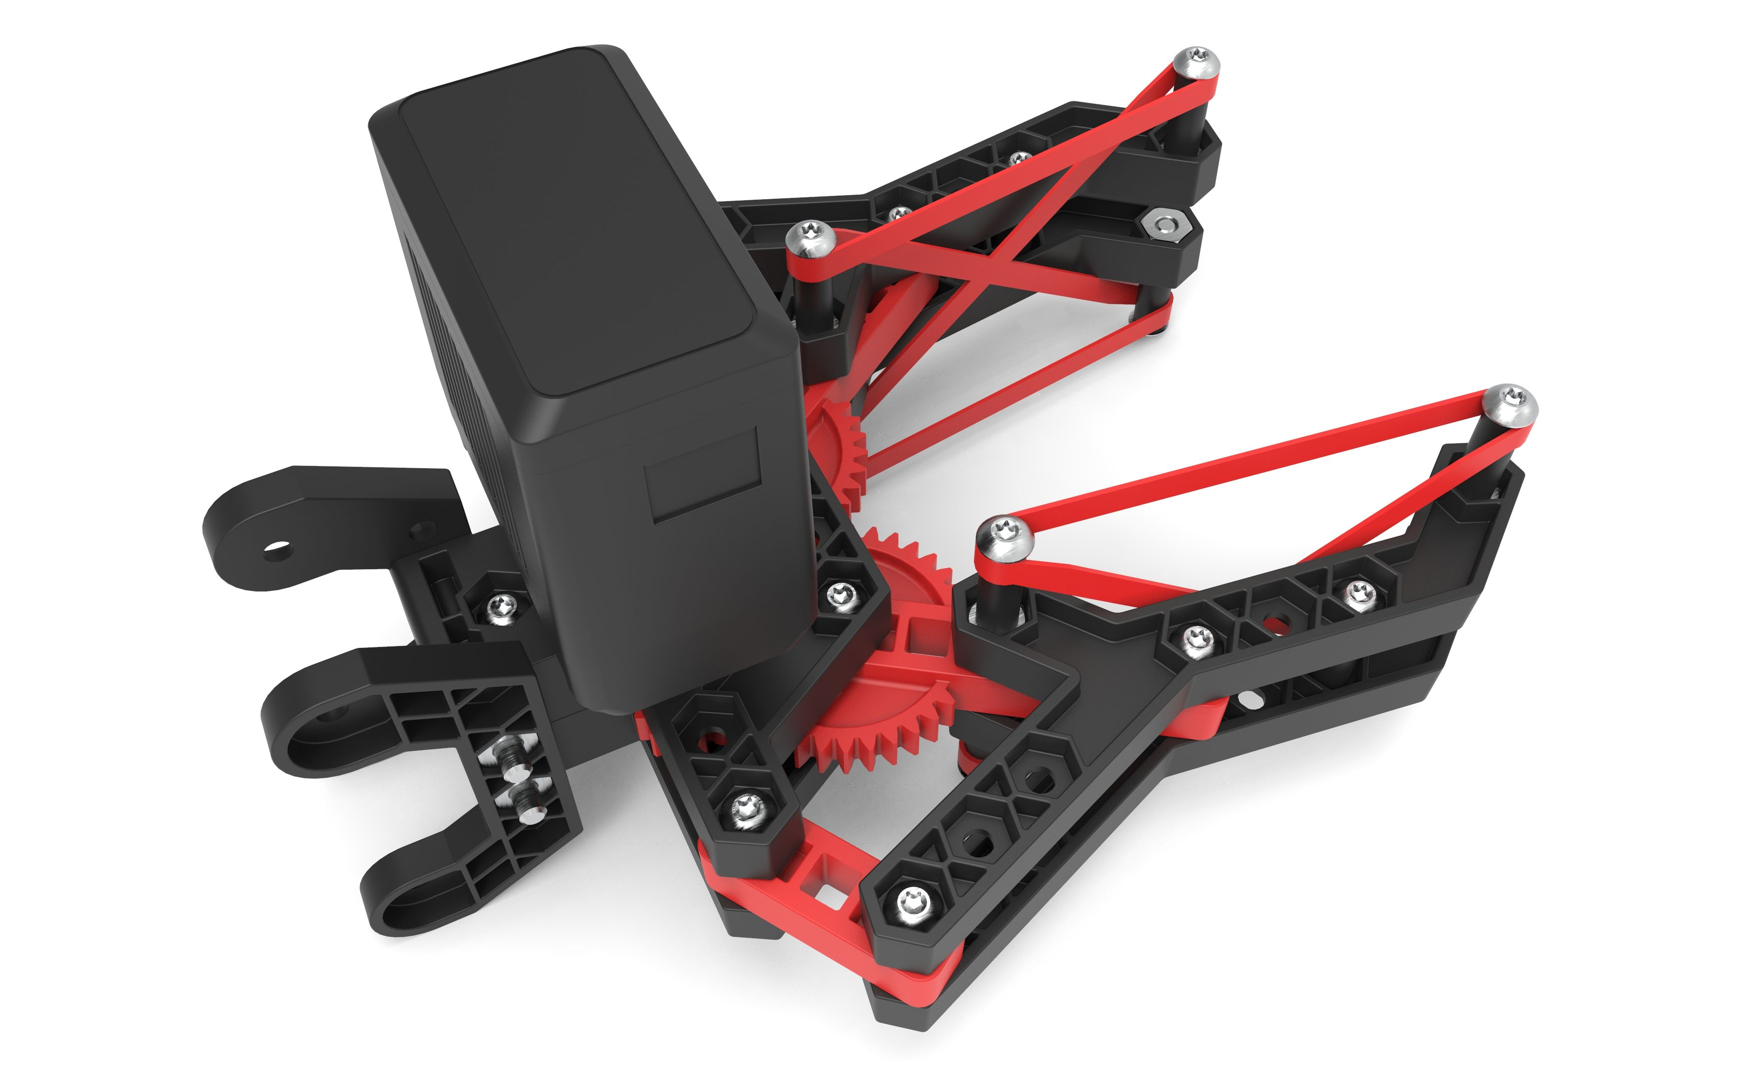
Limitations
Tunnel does not have line, accurate orientation and travel distance measurement required, limit switches as possible redundancies
Enough torque to climb ramp is required
Stalling servo motor is a risk, use of rubber bands to increase friction and prevent stalling
For lifting mechanism: height of tunnel and complexity of design may increase fabrication time, claw with attached motor is heavy
Minimum clearance to ascend ramp required
Tunnel width limits size.

Slide 8

ANY QUESTIONS?

